Slide 1
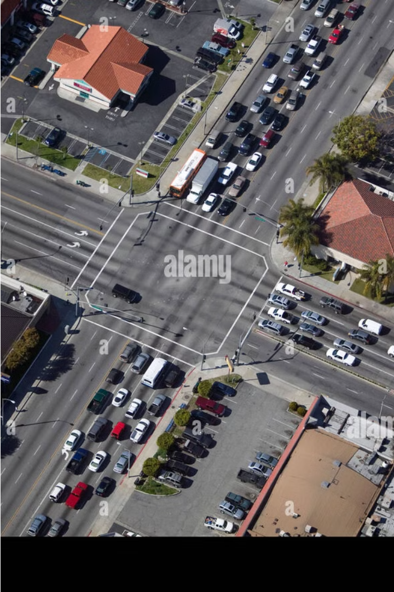
Introduction to 4-Way Traffic Control System
The 4-way traffic control system is a critical infrastructure that ensures the safe and efficient flow of vehicles, pedestrians, and cyclists at busy intersections. This comprehensive system utilizes traffic signals, sensors, and coordinated algorithms to manage the complex dynamics of multi-directional traffic.

Slide 2

ABOUT THE PROJECT
The Traffic Light Control System project aims to develop an efficient and reliable method for managing urban traffic flow using fundamental digital circuitry components. This system leverages the capabilities of the IC 4017 decade counter and the versatile 555 timer IC to control the illumination of Red, Yellow, and Green LEDs, simulating a real-world traffic signal operation. The 555 timer functions as a clock generator, delivering periodic pulses to the 4017 counter IC, which sequentially activates the LEDs corresponding to the standard traffic light sequence. The duration for which each LED remains lit is dictated by the pulse width of the 555 timer, adjustable via an integrated potentiometer. This configuration allows for fine-tuning of the signal timing, ensuring optimal traffic flow management. By utilizing readily available electronic components, this project demonstrates a practical and scalable approach to traffic control, emphasizing simplicity, cost-effectiveness, and adaptability in various traffic scenarios.

Slide 3
Key Components of 4-Way Traffic Control
IC’s
Flip-Flops
LED’s
Integrated circuit, is a tiny chip that crams a bunch of transistors and other electronic components together. This lets them perform complex electronic functions.
Flip flops can refer to sandals with a thong separating the big toe or to a digital circuit that stores data. This second meaning is used in electronics like computers
LEDs are tiny, energy-efficient lights that come in many colors. They're used in everything from traffic signals to phone screens.

Slide 4
COMPONENTS USED:
AND GATE:
OR GATE:
NOT GATE:
An AND gate outputs a 1 (high) only if ALL its inputs are 1s (high). Think of it as needing multiple keys to unlock a door.
An OR gate outputs a 1 (high) if ANY of its inputs are 1s (high). Imagine it as needing just one key to unlock a door.
A NOT gate flips the input. If you give it a 1, it outputs a 0, and vice versa. Think of it as a switch for logic.

Slide 5
COMPONENTS USED:
CLOCK
A clock tracks time with moving hands or a digital display, helping us manage our schedules and stay on track.
T FLIP-FLOP
A T flip-flop is a digital circuit that acts like a toggle switch. Each clock pulse flips its output from 0 to 1 or 1 to 0. They're useful in counting circuits.
LED
An LED, or light-emitting diode, is a tiny light source that uses electricity to shine. They're very efficient and come in a rainbow of colors. You see them everywhere, from traffic lights to phone screens.

Slide 6
OBJECTIVE:
TO DESIGN A TRAFFIC SIGNAL CONTROLLING CIRCUIT USING DIGITAL LOGIC FOR VEHICLES CROSSING.
TO IMPLEMENT DIGITAL LOGIC FOR RED YELLOW GREEN LIGHTS (VEHICLES).

Slide 7
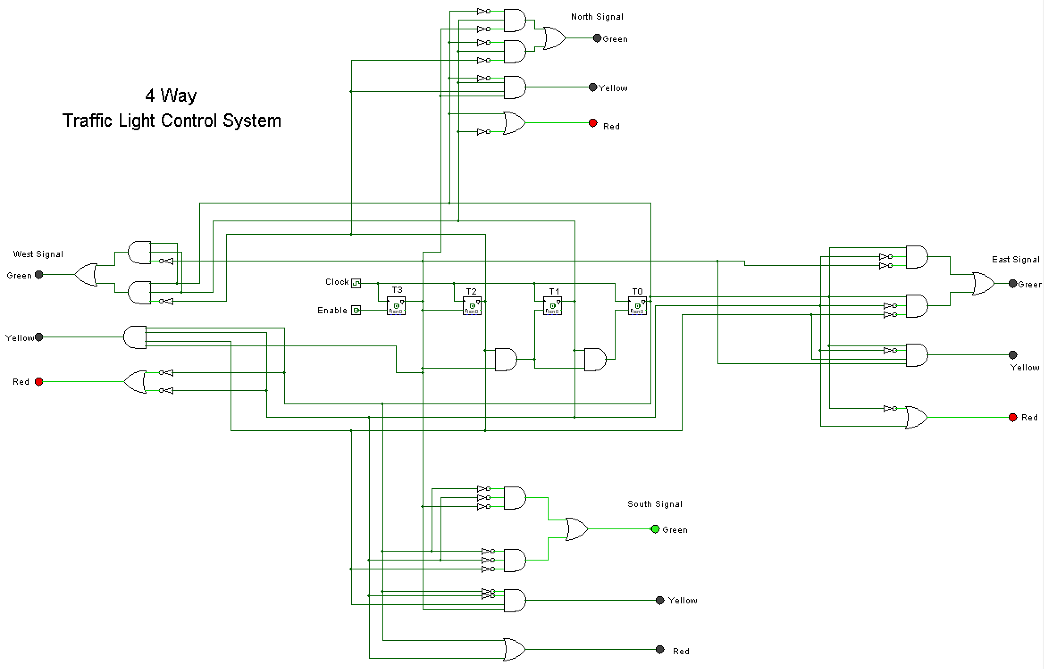

Slide 8
RESULT:
A 4 WAY TRAFFIC SIGNAL CONTROLLING CIRCUIT USING DIGITAL LOGIC FOR VEHICLES CROSSING IS OBSERVED.
DIGITAL LOGIC FOR RED YELLOW GREEN LIGHTS (VEHICLES) IS OBSERVED.

